Slide 1
Key Performance Indicators
Key Performance Indicators
By: Valerie Jennings, CEO
Sophie Shafter, Communications Director

Slide 2
Reporting
Establish KPIs
Research Benchmarks
Use Reporting Tools
Evaluate Campaigns
Sales Reports
32
Notes:
Create key performance indicators that are widely accepted for your business and industry.
data to accurately measure growth.
Make sure to know what the numbers mean. You will need to research benchmarks that are specific to your industry and that are updated for 2020. Social media benchmarks by industry are inconsistent.
To automate data from Google & social media ads us tools such as Agency Analytics, Zoho, Google Data Studio. Double check data across platforms. Integrate CRM, email tool and website.
Report the performance of your campaigns. Set clear goals before you start and ways to report the success or ways to do better in the future. Such as RSVPs, ticket sales or how successful a campaign is generating leads.
Zoho provides a sales dashboard and insights to understand how your marketing and sales programs intersect.

Slide 3
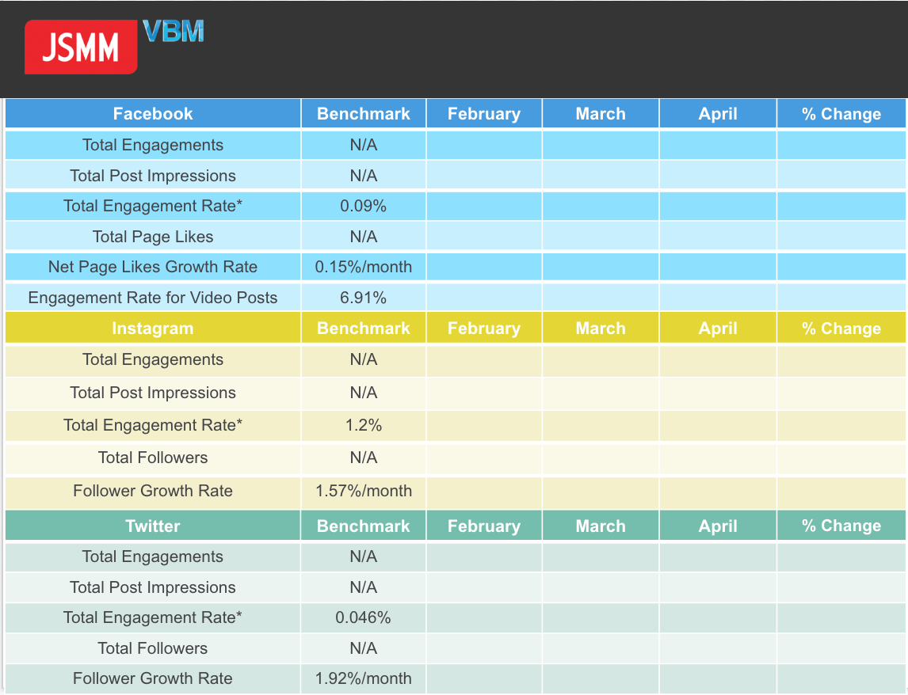

Slide 4
Most Important KPIs For Success
Return On Marketing Investment (ROMI)
Qualified Leads
Referrals
Leads
Brand
Awareness
Cost Of Customer Acquisition (CAC)
Customer Lifetime Value (CLV)
Testimonials And Reviews
Source: SOCIALMEDIAtoday
59
Notes:
Leads - Generating leads is one of the hardest and most important marketing tasks. Most of what marketing does is aimed at finding or producing leads - people that are potentially interested in your product and can be converted into paying customers. Tracking leads is the first thing you should be doing. It’s vital to both track the total number of leads generated per month and leads generated by each marketing channel (social media marketing, social advertising, search advertising, content marketing, email marketing, etc).
Qualified leads - Measuring your 'qualified leads' is your next key step. Qualified leads are leads that you’ve seen some level of engagement from - they're no longer 'potentially' interested in your product, they’ve actually replied to your outreach, or engaged in any other way, and can now be transferred to your sales team.
Return on marketing investment (ROMI) - As is clear from its name, ROMI doesn’t differ a lot from the more well-known 'return on investment' (ROI) metric. But it focuses more specifically on marketing investment - the ROMI metric measures how much revenue a marketing campaign is generating compared to the cost of running that campaign. ROMI is calculated using this formula: ROMI = (income from marketing – cost of goods – marketing expenditures) / marketing expenditures) * 100.
Referrals - Businesses often neglect tracking referrals, but it's an important consideration, especially in digital marketing.
Brand awareness - Brand awareness is, essentially, the extent to which consumers are familiar with a particular brand. It might be one of the most vague metrics on this list, as it's hard to assess how many people have heard about the brand. But it can also be valuable, particularly when matched against competitor brands.
Testimonials and reviews - Testimonials and reviews are also known as 'word-of-mouth marketing'. Every business should encourage reviews and testimonials - they can make or break your sales when a potential customer searches for your brand online. And, of course, these are also worth measuring.
Cost of customer acquisition (CAC) - Cost of customer acquisition looks at how much it costs, on average, to convert a lead into a customer. It’s another metric, in addition to ROMI, that can help you avoid wasting money on marketing campaigns which simply don’t deliver. CAC is calculated with the formula: Amount spent on lead generation / Number of new customers as a result of lead generation = Cost of customer acquisition
Customer lifetime value (CLV) - Customer lifetime value shows how much revenue each customer brings to your business, not just with every purchase, but throughout your whole relationship. CLV shows how many customers you need to break even, and to make profit. Increasing customer lifetime value is important, as it's usually cheaper to keep an existing customer than it is to convert a new one. The simplest formula to measure CLV is the following: Customer revenue per year x Duration of the relationship in years - Total costs of acquiring and serving the customer = SLV
https://www.socialmediatoday.com/news/8-marketing-metrics-to-focus-on-in-2020/579407/

Slide 5
Questions???
03

Slide 6
Influencer Marketing
Influencer Marketing
By: Valerie Jennings, CEO
Sophie Shafter, Communications Director

Slide 7
Table Of Contents
What is Influencer Marketing?
Why is Influencer Marketing Important?
Who Are Influencers + How Do You Find Them?
Examples of Successful Influencer Marketing Campaigns
How To Build an Influencer Marketing Campaign
Dos and Don’ts of Working with Influencers
01
Notes:
1. Drag & drop image into placeholder.

Slide 8
What is Influencer Marketing?
Endorsements And Product Mentions
Influencers Have Dedicated Social Following
Build Brand Trust
Niche Experts
Social Proof for Your Brand
Source Hubspot + SproutSocial
01
Notes:
At a fundamental level, influencer marketing is a type of social media marketing that uses endorsements and product mentions from influencers–individuals who have a dedicated social following and are viewed as experts within their niche. Influencer marketing works because of the high amount of trust that influencers have built up with their following, and recommendations from them serve as a form of social proof to your brand’s potential customers.

Slide 9
Key Influencer Marketing Terms
Macro: 100,000 - 1 million followers
Micro: 1,000 - 100,000 followers
Nano: 0 - 1,000 followers
Source Hubspot + SproutSocial
02
Notes:
Influencers come in all levels of “celebrity,” often synonymous with audience size. Macro, micro, and nano influencers provide varying levels of investment for marketing budgets.
​Macro Influencer
Well-known online presence with 100,000-1 million followers. A macro influencer’s reach usually spans a broad audience, like young women or teens. These influencers are available for higher budget campaigns.
Micro Influencer
A micro influencer typically has between 1,000-100,000 followers. Micro influencers have more defined and specific audiences and are respected experts in their field. These individuals are less expensive than macro influencers and have great engagement rates.
Nano Influencer
Nano influencers are the smallest in terms of following, but have the best engagement, typically within a local or super niche community. Nano influencers usually have less than 1,000 followers and are selective about the products or brands they endorse.

Slide 10
Influencer Collaborations
When Running a Campaign Consider:
Expertise
Reach
Demographic / Audience
“Celebrity” / Notoriety
Source Hubspot + SproutSocial
03
Notes:
When considering what type of campaign you’d like to run for a given project, consider the following factors.
Influencer Marketing Campaign Variables
• Expertise: Does the content you are promoting or product you sell match with the influencer’s audience?
• Reach: Is this influencer present on the same channels and platforms as your audience? For example, if your target audience is in their teens, it may not be useful to reach out to an influencer whose main following is on LinkedIn.
• Demographic/Audience: Does your buyer persona match this influencer’s following? What does a typical follower of their audience look like?
• “Celebrity”/Notoriety: Is this influencer generally well-liked?

Slide 11
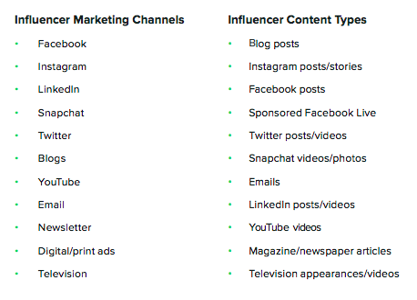
Channels / Content Types
Source Hubspot + SproutSocial
04
Notes:
1. Drag & drop image into placeholder.
2. Remove background from your photos for better performance (use photoshop or powerpoint ”remove background” option)

Slide 12
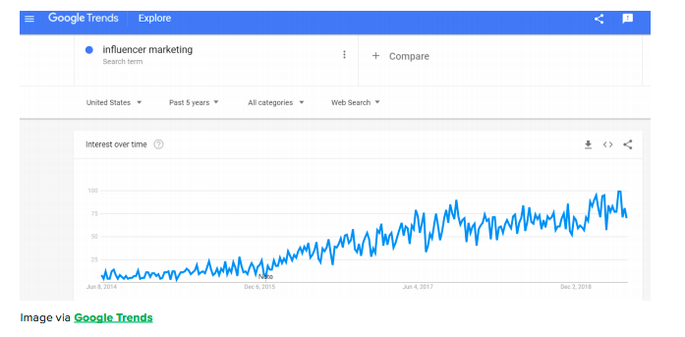
Why Influencer Marketing Is Important?
Grown by 1500% in the past 4 years!
Source Hubspot + SproutSocial
02
Notes:
Influencer marketing is growing at an incredible pace, and for a good reason. Searches for influencer marketing have grown by 1500% in the past four years.

Slide 13
Influencer Marketing Statistics
80% Helpful For Growth
71% Better Quality
Over ½ Pop. Follows
49% Rely On For Purchase Decisions
Source Hubspot + SproutSocial
10
Notes:
80% of marketers have found that influencer marketing has been helpful in growing their business.
71% of marketers find that influencer marketing leads are better quality than other lead generation sources.
Over half of the online population follows a celebrity or influencer on social.
49% of buyers rely on influencers for purchase decisions

Slide 14
Who Are Influencers?
Influencers have a highly engaged audience on social media, so access to them serves as a powerful marketing tool to boost qualified traffic to your website. Influencers can help guide your audience to making a buying decision—their advice means a lot to their followers.
Source Hubspot + SproutSocial
03
Notes:
Influencers have a highly engaged audience on social media, so access to them serves as a powerful marketing tool to boost qualified trac to your website. Influencers can help guide your audience to making a buying decision—their advice means a lot to their followers.
Influencers can range from macro influencers and celebrities to niche, nano influencers with smaller social media followings. So, when you’re scrolling through Twitter and see someone with over 1,000 followers, how can you tell who is an “influencer”?

Slide 15
Find In A Specific Field
.
FIND THEM IN THEIR SPACE
LISTEN
ONLINE RESOURCES AND TOOLS
ANALYZE PAST PERFORMANCE
Source Hubspot + SproutSocial
13
Notes:
Listen: Search platforms by hashtag, celebrity, or related topic. You’ll start to notice the same users’ posts and their engagement is consistent and organic with their followers.
Find them in their space: Lots of photography and lifestyle influencers use online platforms that connect content creators with companies. You can also use LinkedIn, Twitter, Facebook, or Instagram to directly reach out to influencers who inspire you and align with your brand. Often a personal first touch from a social media manager will have more impact than outreach from your brand account.
Use online resources and tools like Buzzstream and Buzzsumo oto find influencers in fields like tech, communications, retail, and more, as well as manage influencer campaigns.
Analyze past performance: Take a look at an individual’s post performance across social media platforms. Does a certain influencer get 1 million likes on Facebook posts but is lacking on Instagram? Consider how and where you’d like to partner with them.

Slide 16
Macro Influencer:
Gary Vaynerchuk,
3M LinkedIn Followers
VaynerMedia
Content Daily
Podcast
Source Hubspot + SproutSocial
26
Notes:
Gary Vaynerchuk is best known for his work in digital marketing and social media, through New York–based VaynerMedia. Today, Gary has more than 12M combined followers across social media, producing content daily on Instagram, YouTube, Facebook, Twitter, LinkedIn, Snapchat, Spotify and more. Gary also hosts a global top 100 business podcast, The GaryVee Audio Experience, which features new episodes every day.

Slide 17
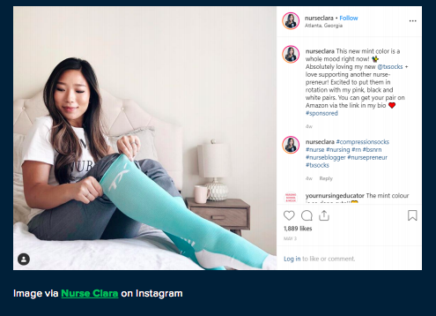
Micro Influencer:
Nurse Clara
57.4K Instagram Followers
Registered Nurse
Lifestyle Blog / Insta
Relevant Products
Niche Professional
Source Hubspot + SproutSocial
Notes:
Clara Jones is a Registered Nurse who has a lifestyle blog and Instagram account. She partners with brands like TX Compression Socks, Figs scrubs, and other nursing and lifestyle brands to incorporate relevant products for her followers. Many niche professionals often share recommendations and favorite products.

Slide 18
Breakout Session
EXERCISE
Use the search function for each channel, and search by hashtags to identify 3 Influencers (Celebrity or Micro-Influencer) in your area of expertise on Twitter, Instagram and LinkedIn
DISCUSSION
Discuss which influencers you identified.
Who are some of their key followers?
How does this influencer impact your industry?
What is appealing about their content?
What are the differences in the types of content posted to each different channel?
Source Hubspot + SproutSocial
17
Notes:
1. Drag & drop image into placeholder.

Slide 19
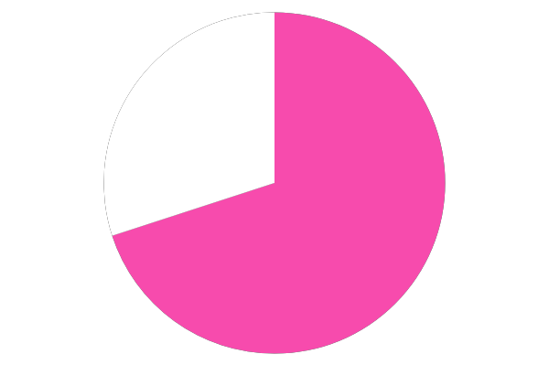
How to Build an Influencer Marketing Campaign
Step Two: Outreach
Step One: Research
Source Hubspot + SproutSocial
22
Notes:
Step One: Research
Determine where your audience lives. Start by analyzing the demographics of your social audiences as well as those of your competitors. Research common hashtags and explore the top influencers in your industry. Listen to identify key social conversations and influencers discussing your brand, product or industry. Search through their followers and find an influencer whose size and rough budget aligns with your brand and goals.
Step Two: Outreach
Once you’ve identified some candidates, start your outreach. Follow or connect with people you respect and be honest about what you’re looking for. If you have influencer contacts, ask for an introduction or a warm hando. LinkedIn can be a great resource to find mutual connections to influencers in your field.

Slide 20
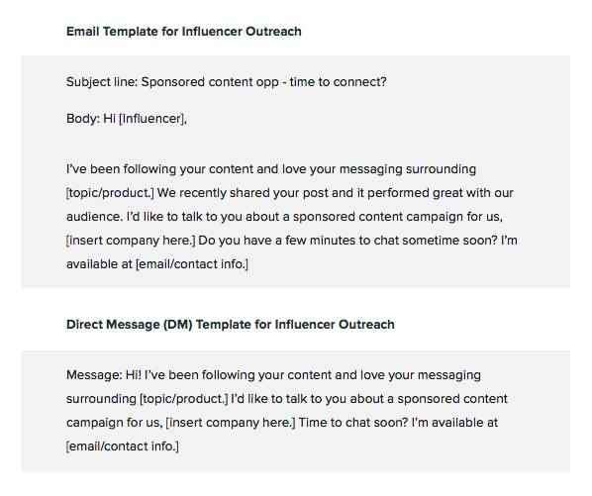
Examples
Messaging for Influencer Outreach
Source Hubspot + SproutSocial

Slide 21
Who is your target audience or buyer persona? Key demographic?
Campaign Goals and Timeline
Identify a timeline, goals or KPIs, and any requirements, legal restraints, or guidelines.
Create a contract.
50
Source Hubspot + SproutSocial
Notes:
Who is your target audience or buyer persona? Key demographic? Create a detailed campaign plan. If you’ll be using multiple influencers, use a common hashtag, like Trello’s recent #ReadySetGoal campaign.
Work with the influencer to identify a timeline, goals or KPIs, and any requirements, legal restraints, or guidelines. Make sure your goals are SMART—specific, measurable, attainable, realistic, and time-bound. Here’s a free template for creating SMART goals.
Create a contract detailing both the influencer’s deliverables and the agreed upon fee and payment timeline/method. This is a good opportunity to provide brand style guides, font files, brand colors, or any other resources they may need. Make sure you agree on messaging and give good examples of similar posts that inspire you and align with your brand.

Slide 22
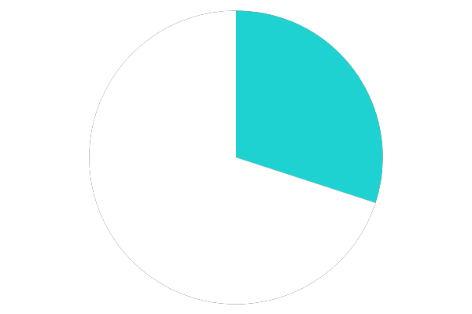
Campaign Budget
When considering budget, consider the quality of the leads you’ll generate.
When considering how much you’ll be paying influencers, most will have a certain price they charge per post or campaign.
Source Hubspot + SproutSocial
22
Notes:
When considering budget, consider the quality of the leads you’ll generate. Compare the cost-per-click, cost-per-lead, or cost-per-sale you spend on comparable programs like social media advertising or sponsored newsletters. Expect to pay more, as influencers’ followers are curated and less frequently targeted with ads than brand accounts, therefore more engaged and higher quality.
When considering how much you’ll be paying influencers, most will have a certain price they charge per post or campaign. To get a gauge on how much you should be paying influencers at each level, first determine what type of influencer they are. Micro influencers typically charge $80-500 per post and macro or celebrity influencers charge between $3,000-500,000+ per post. Nano influencers are often looking for partnerships to help grow their brand and name. Many are happy to receive free products in exchange for a sponsored post.

Slide 23
Breakout Session
EXERCISE
Using the influencers you identified in the previous exercise, create a campaign outlining the campaign goal, messaging, branded hashtag and how the influencer will execute (Instagram post and stories, LinkedIn blog post, Tweets utilizing a trending hashtag, etc.)
DISCUSSION
Share your favorite campaign ideas, branded hashtags
What were some of the challenges in creating your campaign?
Does this give you a better understanding of who influencers are and how to work with them?
Source Hubspot + SproutSocial
17
Notes:
EXERCISE>
Using the influencers you identified in the previous exercise, create a campaign outlining the campaign goal, messaging, branded hashtag and how the influencer will execute (Instagram post and stories, LinkedIn blog post, Tweets utilizing a trending hashtag, etc.)
<DISCUSSION>
-Share your favorite campaign ideas, branded hashtags
-What were some of the challenges in creating your campaign?
-Does this give you a better understanding of who influencers are and how to work with them?

Slide 24
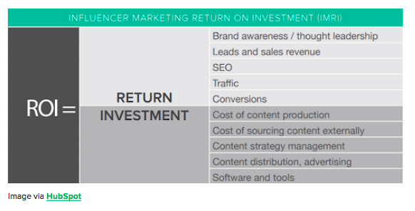
Analytics and ROI
Engagement
Impressions
Reach
Results/Resonance
Source Hubspot + SproutSocial
Notes:
After a campaign or a post goes live, you’ll need to look out for these metrics.
• Engagement: this includes likes, shares, comments, reposts, and any other interaction with the post
• Impressions: numbers of times a piece of content has been viewed. Can be considered as the “actual views” metric.
• Reach: number of followers an influencer has on either on or all social media platforms combined. It is an indicator of audience size, which is helpful for marketers to forecast potential impressions.
• Results/Resonance: how many people took action based on the post. This can be tracked using UTM tracking links.

Slide 25
Influencer Marketing Campaign Checklist
Campaign Checklist:
Campaign brief
Terms & conditions of contract
Creative Release Agreement
Non-disclosure Agreement
Brand/content guidelines
UTM templates and tracking
Recommended Influencer Marketing Tools:
Sprout Social
HubSpot CRM
BuzzStream
Buzzsumo
Source Hubspot + SproutSocial
04
Notes:
1. Drag & drop image into placeholder.
2. Remove background from your photos for better performance (use photoshop or powerpoint ”remove background” option)

Slide 26
Dos And Don’ts
Dos
Pay Influencers on time within the agreed upon payment.
Give helpful feedback.
Use mutually beneficial goals.
Send thoughtful gifts and thank you notes.
Interact with them frequently.
Don’ts
Don’t try to force your product or brand on an influencer whose audience doesn’t align with yours.
Don’t go rogue and run a campaign without a proper tracking setup.
Source Hubspot + SproutSocial
Notes:
Dos
-Do pay influencers on time and within the agreed upon payment period terms. Creating and maintaining a good relationship is crucial for the success of the campaign.
-Do give helpful feedback and provide as much data as possible to the influencer.
-Do use mutually beneficial goals that are agreed upon before the campaign starts.
-Do send thoughtful gifts and thank you notes following successful campaigns or as an intro.
-Do interact with them frequently and organically on social media.
Don’ts
-Don’t try to force your product or brand on an influencer whose audience doesn’t align with yours. This will only hurt both parties and be a waste of money.
-Don’t go rogue and run a campaign without a proper tracking setup. It’ll be a challenge to try to associate sales with the influencer’s work after the fact.

Slide 27
Resources
Does Influencer Marketing Actually Work
5 Great Examples of Instagram Influencer Marketing
How To Work With Influencers—The Ultimate Guide
An Expert’s Guide To Influencer Marketing
Source Hubspot + SproutSocial
24
Notes:
1. Drag & drop image into placeholder.

Slide 28
Questions???
03

