Slide 4
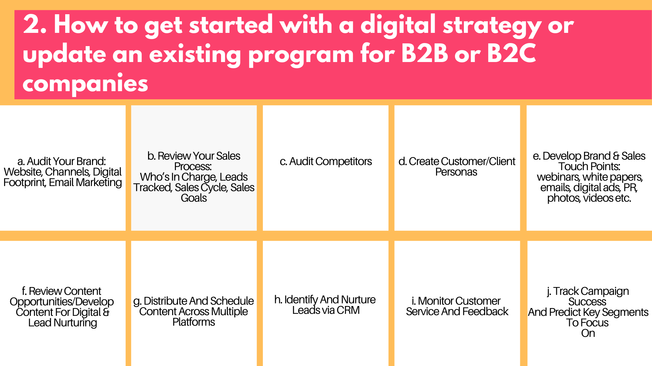

Slide 5
Notes:
Competitors (SEO/social) - Use tools like SEMrush and SocialInsider to check up on what your competitors are doing and to generate ideas to stay ahead. Alexa and WhatRunsWhere. Signup for competitor e-newsletters.
Site Speed - Most people will not wait more than 3 seconds for your site to load. So making sure your website is performing at top speed by using the Google website speed tool.
Security Certificates - A website security certificate is also known as an SSL certificate. It allows you to display the padlock in the web address bar. This shows your customers your site is secure while also protecting your business from hackers.
Mobile-optimized - Today it is very important to have your website accessible on mobile devices. Around 2 billion people currently access the internet via only their smartphone.
Website - Do monthly audits on your website to make sure that is up to trends, working correctly and your SEO is in good standing. 2020 Design and brand trends have drastically changed. Google Search Console will provide reports or tools like MOZ, etc.

Slide 6
Notes:
CRM - Customer Relationship Management - all in one MarTech and sales platform. Organize leads, sales funnel and reports.
Email Marketing - campaigns are topical, time-sensitive and personal from leadership. Types of emails: personal, company newsletter, welcome emails, nurturing emails.
Downloadable Content - Having downloadable content on your website not only lets you give something to your users that can show them you are a thought leader, you can also add them to a customized email marketing campaign that can move them into your funnel. Quizzes, checklists, case studies, brochures, decks.
Webinars - Now more than ever, people are taking advantage of webinars to expand their knowledge. This is an opportunity for you to build your reputation among other business members and your community.
Videos - Creating original videos will show your clients a more personal view and help them feel closer to the brand. 83% of marketers believe that video is becoming increasingly important, which signals more brands will start using video as part of their digital marketing strategies.
Infographics - Many tools such as Canva, PicMonkey, Piktochart to test.
Original Photos - It’s incredibly important to have a cohesive brand. Original photos perform best. Canva is also an affordable solution. Be careful of using copyright protected materials.

Slide 7
Notes:
What is a marketing persona? Personas are archetypal characters created to represent the different user types within a targeted demographic, attitude or behavior set that might use a site, brand or product in a similar way. Personas are often combined with market segmentation to represent specific customers.
Why are personas necessary? Personas are a way to consider the goals, desires and limitations of your customers. They are used to guide decisions about a service, product, interaction, feature and visual design of a website.
What are the benefits?
Consistency across the business for marketing messages and lead definition.
Better organizational understanding of your customer’s needs, wants and desires.
Understanding where your customers are spending their time will enable better targeting of content and promotion opportunities.
Better quality sales leads and lead nurturing programs for different personas.
More targeted analytics as you can discover which types of personas make better customers.
How to make them? You can find examples by simply Googling the persona you are looking for. If you are a fitness company look type in “marketing persona for people into fitness.”

Slide 8
Notes:
Your brand represents your values, trust, products, services, culture, innovation and more. 2020 design trends have changed.
Editorial Calendar - Create an editorial calendar that has all of your marketing plans, social media posts and email marketing campaigns to stay organized and on task. Use NationalDayCalendar, Original Assets, Key Messages, Show Behind-The-Scenes Shots
E. Social Media - Maintain a cohesive look on all social media channels while staying on trend with the latest fonts, colors and designs.

Slide 9
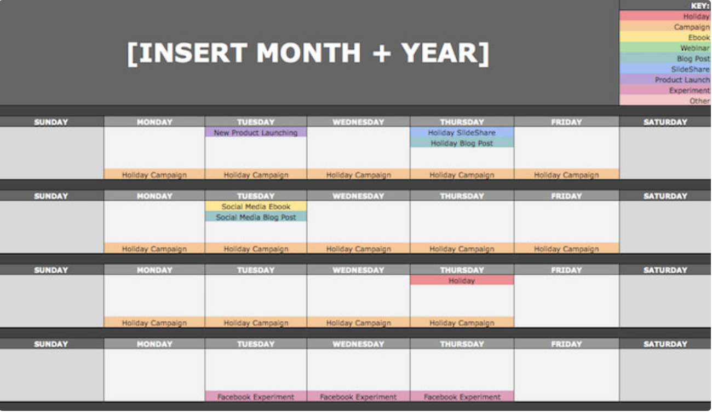

Slide 10
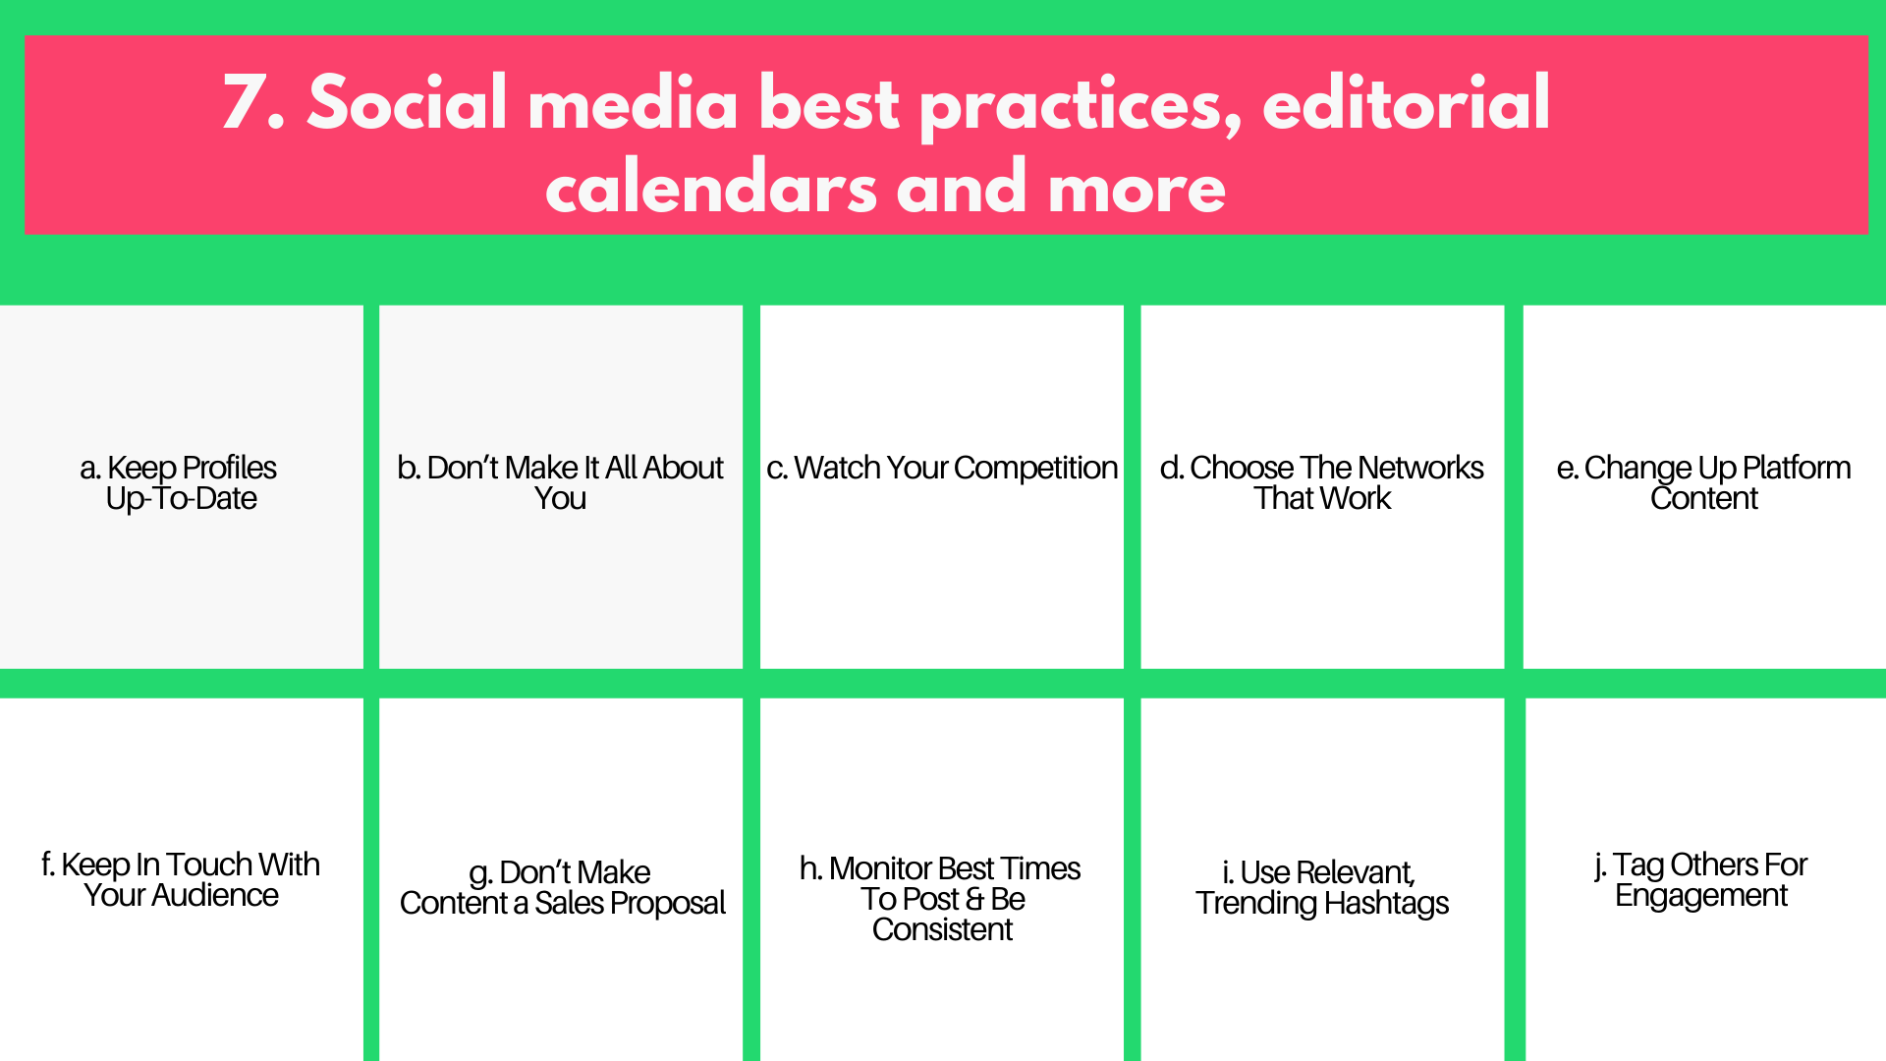

Slide 11
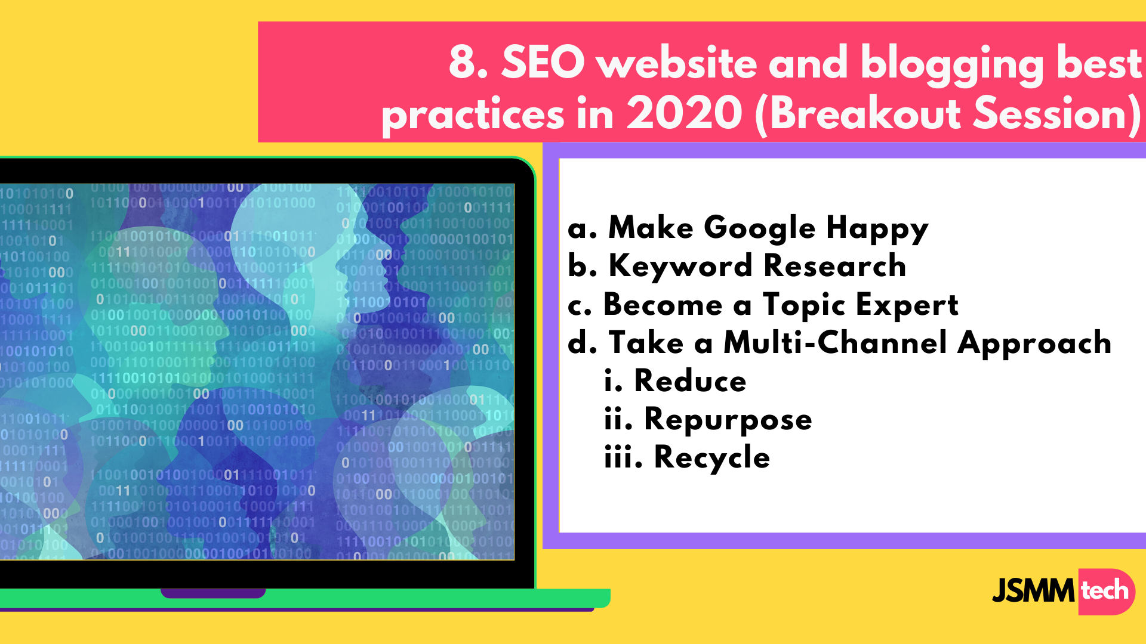
Notes:
Google has its own goals and they are frequently updated.
Create content that Google wants to show because it will be helpful to their user.
If your goal is to rank for keywords then you need to know which keywords are being searched for and have a plan for which pages are trying to rank for which keywords. What are people searching for related to your product or industry? Are there commonly asked questions that appear as search results? Are people looking for recommendations or tips on related content? Are there a few similarly themed questions that you're able to answer in a blog post? Many of the keywords you'll try to rank for depend on the website's traffic & domain authority. Try UberSuggest by Neil Patel.
For instance, you could pay a lawyer to write a blog post about “What is SEO?”, but they are likely to miss some important points, nuances, and “isms” that make the content click with an audience that is looking to learn SEO. Further, having some credentials behind your name is likely to give your content even more validity and help you build trust with your audience.
Now, there are only so many hours in a day and not everyone can afford a team that circulates content around the clock. But there are some tips we can pick up from Gary Vee’s content marketing strategy:
dense content out into bite-size chunks to be marketed across multiple channels.
Effective content marketing doesn’t mean having to create fresh content every single day (or, even, every week).
Instead, you can use the same outline for a single piece of content to create content for different platforms.
Breathe life into your old content by giving it a revamp and sharing it with a new audience. Perhaps you have an old blog article that was popular when it first went live, but it got buried deep in your blog. Upcycle it with new information and share it on social media to drive new traffic to your site.

Slide 12
Notes:
E. For SEO professionals, I highly recommend tools like Grammarly, ContentRow, and CoSchedule’s Headline Analyzer to ensure that your content is user-friendly, engaging, and click-worthy.
F. Since the nature of a trend is that it tends to be short-lived, you may not generate long-term traffic through this approach, but you can see a surge in traffic overnight. Consider that “Taylor Swift” was trending (according to Google Trends) right around the time that her new documentary dropped. You can also pugin certain potential headlines to see what other topics are generated or use UberSuggest.
G. i. using headline analyzer and generator tools. Be sure to exclude clickbait. Tools we suggest are content row and EMOTIONAL MARKETING VALUE Headline Analyzer.
Ii. Posts should be a minimum of 1000 words but preferably 2000+.
Iii. Google's updated algorithm is looking for amazing visuals such as videos or infographics. Try to include one media file for every 350 words.
Iv. Link to multiple, high-quality sources and provide data.
V. Submit your blog post to Google to index by adding it to your site map.
Vi. Remove blog posts from your blog that are too short - these can actually hurt your SEO.
Vii. Update blogs that have performed well in the past - this can improve your SEO. Try updating resources, facts or stats and media files.

Slide 13
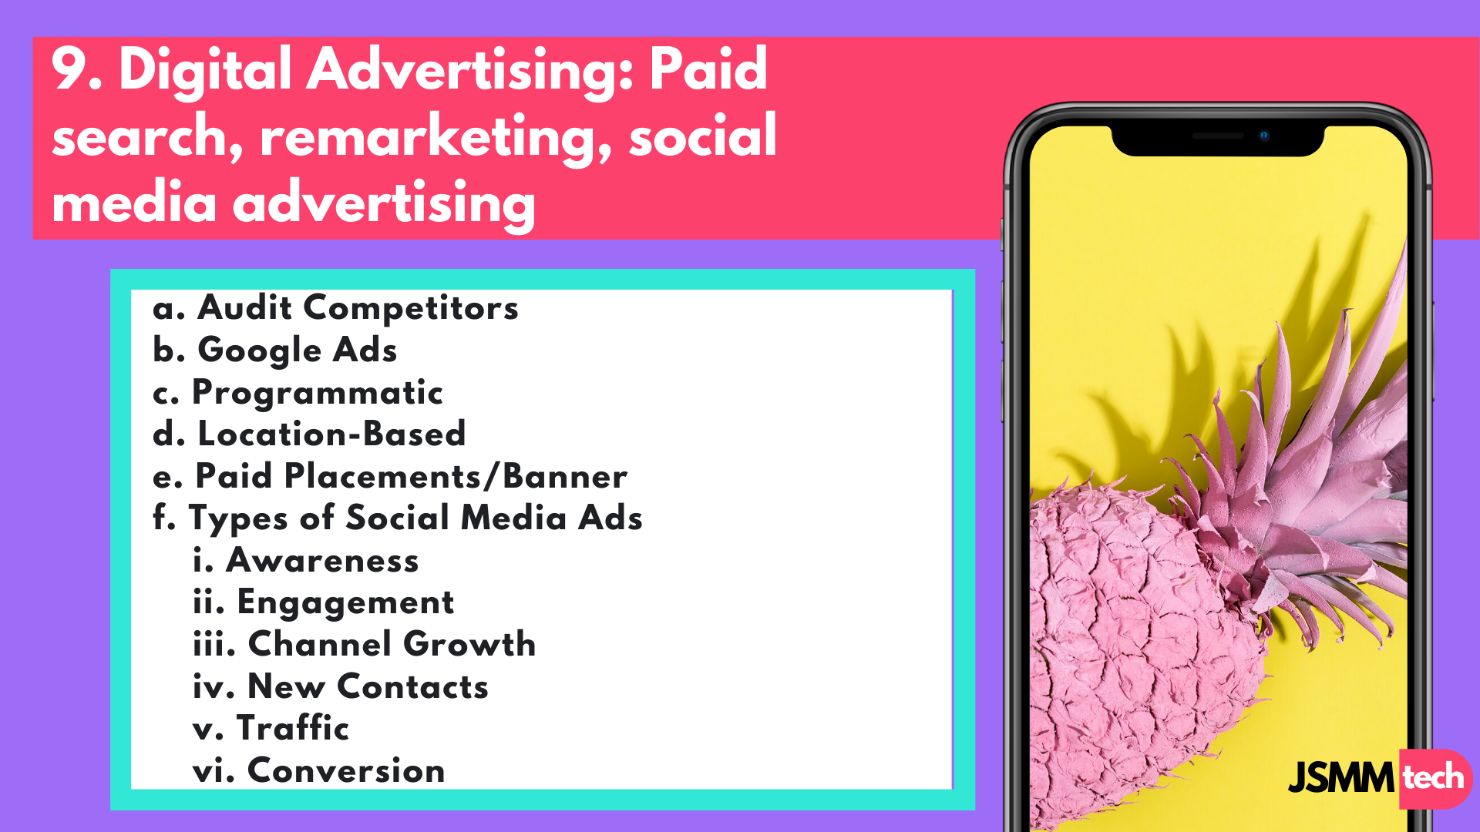
Notes:
REACH SLIDE / AUDITING COMPRETITORS TAKE IT TO SEO AND COMPETITIORS
SEMRush, WhatRunsWhere
Identify competitor keywords, set up tracking, media buy plan, create ads, monitor success
Adroll
Geofencing
Industry news sites

Slide 14
Notes:
Create key performance indicators that are widely accepted for your business and industry.
data to accurately measure growth.
Make sure to know what the numbers mean. You will need to research benchmarks that are specific to your industry and that are updated for 2020. Social media benchmarks by industry are inconsistent.
To automate data from Google & social media ads us tools such as Agency Analytics, Zoho, Google Data Studio. Double check data across platforms. Integrate CRM, email tool and website.
Report the performance of your campaigns. Set clear goals before you start and ways to report the success or ways to do better in the future. Such as RSVPs, ticket sales or how successful a campaign is generating leads.
Zoho provides a sales dashboard and insights to understand how your marketing and sales programs intersect.

Slide 15
